Slide 1
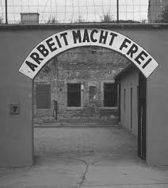
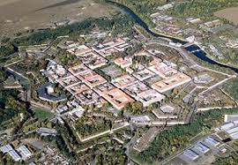
The Nazi Show Camp: Theresienstadt and the 1944 International Red Cross Visit
By: Erik M. LaFortune

Slide 2
Theresienstadt: The Gates Open
Fortress Camp in Czechoslovakia
Nazi Propaganda
Retirement or “spa camp”
Reality
Transit Camp (not an End Camp)
Danish Jews 1943
Danes attempted to avoid transport of Jews but 456 were gathered and sent to Theresienstadt
King Christian, the Danes, and the Swedes pressured the Nazis to visit Camp and Danish Jews
Nazi Propaganda opportunity and began an eight month beautification process
Wealthy German Jews board trains to Theresienstadt after paying handsomely for a chance to live there.

Slide 3
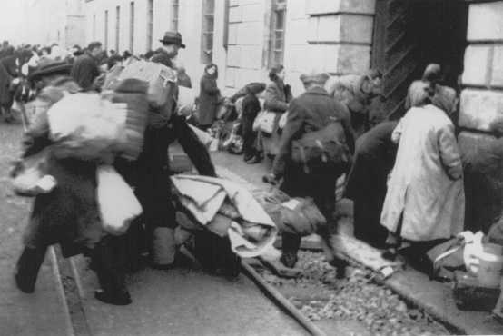
The Visit And Nazi Fraud
June 23, 1944 International Visit
Dr. Maurice Rossel: International Committee of the Red Cross
Dr. Frans Hvass and Dr. E. Juel-Henningsen: Danish representatives
ICRC and Danish Reports filed after the visit described Theresienstadt in a positive light
Rossel concluded his report, “If…this report should contribute in some small measure to dispelling the mystery surrounding the Theresienstadt Ghetto, we shall be satisfied.”
Research Question- How was it possible for the Nazis to fool three highly educated men into believing the elaborate farce?
Wealthy Dutch Jews arrive at Theresienstadt.

Slide 4
Thesis
The Nazis successfully used Jewish forced labor in the beautification process;
They exploited healthy looking Jews to participate and act during the visit;
The charade fooled the ICRC and Danish delegations who wrote favorable reports of the camp;
The reports diminished some international scrutiny over Nazi concentration camps;
BUT: ultimately, the truth about Theresienstadt was already known by the ICRC and the U.S.
Jews eager to begin their comfortable retirements in the “spa town” of Theresienstadt.

Slide 5
Beautification
Nazis deported thousands of Jews to ease overcrowding (around 10,000 to the Auschwitz “family camp”) in preparation for the visit.
Nazis used Jewish forced labor to beautify the façade of Theresienstadt
Tore down old buildings
Repainted and beautified façades of existing buildings
Repaired & cleaned streets
First floor shops created and stocked with merchandise to appear like a normal town (grocery, bakery, pharmacy, lingerie, perfumery)
Newly renovated, spacious, and well-furnished housing on first floors for prominent Jews and Danes (emaciated masses relegated to over-crowded upper floors)
Painting by Norbert Troller (Camp Prisoner)

Slide 6
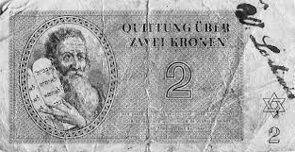
More Beautification
To give the impression of a “spa town” the Nazis forced Jews to construct:
Restaurant with sidewalk tables
Café with stage for musicians
Grassy park with bandstand, concrete benches, meandering paths, rose bushes (top left)
Children’s playground, school, and theater
Library, court, synagogue, renovated hospital, public kitchens, laundry facilities
Bank with camp currency (bottom left) and salaries paid to prisoners on a weekly basis (at least in the ledger book)

Slide 7
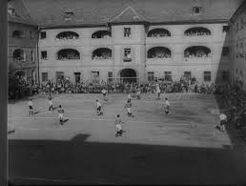
Art, Music, Theater, Sports
Nazis selected healthy Jews to partake in an elaborate charade and act on the day of the visit:
Children’s opera performance of Brundibar (top right)
Orchestra performance of Verdi’s Requiem in the park
Artistic signs and paintings everywhere
Soccer competition (bottom right)
Hundreds of Jews to act normal and happy during the visit

Slide 8
Deception?
“The arts were cultivated in this ghetto for their value as props intended to fool…the Red Cross…The Nazis went to some lengths to conceal their apocalyptic goal…Red Cross delegations were often fooled into believing…that the camp was a safe haven from war” (Freidl Dicker-Brandeis).
“Some of us knew the distressing final purposes of our internment and the rest suspected it. I believe that we all then guessed and feared that ultimately the Germans would succeed to put us to death…But we wanted to live and, therefore, we convinced ourselves that we had a chance and we nursed diligently our self-deception” (Vera Schiff).
Bedrich Fritta (Jewish Artist at Theresienstadt)

Slide 9
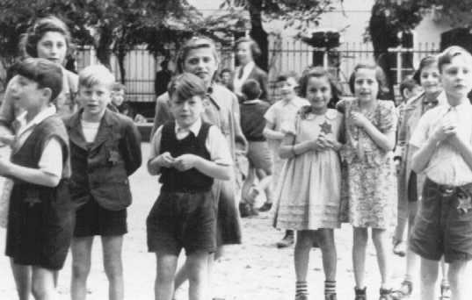
The June 23, 1944 Visit
Only selected healthy-looking Jews were to be seen (prepped and rehearsed for their roles)
Nazis escorted the delegation
Speech by “Mayor” Eppstein- that Theresienstadt was a “normal provincial town”
Only visited a pre-arranged route
Delegation not left alone to speak with the Jews
Music throughout the tour, performances, lunch in café, tour of facilities and buildings (only the first floors along route)
Delegation saw staged actors delivering bread, delivering the mail, women singing in the street on their way to work, a mock trial, a soccer game (top left), and children playing in the playground (bottom left)
All actors recited their scripts perfectly and all were rewarded by Colonel Karl Rahm with a day and half off from work and extra food rations

Slide 10
Reports
Rossel:
Theresienstadt “was a community leading an almost normal existence”
How?
Was he anti-Semitic?
Did he want to be duped?
Was he stupid?
Was the Nazi deception really that good?
In his 1979 Interview (picture from the interview on the right), Rossel claimed:
He was young and “a real naïve, a real know-nothing”
His usual job was to visit prisoner of war camps- not civilian camps
He simply reported what he saw and he would do it again
Interviewer Claude Lanzmann Interviewed Rossel in preparation for the documentary Shoah (relentless interrogation)
“They even had dress rehearsals before your visit, because the nervousness was palpable, they were so afraid that you might have doubts about something…your visit was…teleguided…you saw nothing of Theresienstadt…that you were duped was no surprise, because they wanted to dupe you.”

Slide 11
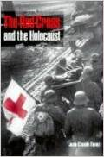
The ICRC Knew the Truth
October 1943 letter (Leo Janowitz to Fritz Ullmann): 1,800 deportees from Theresienstadt currently at Birkenau requested aid
January 1, 1944 letter (in Hebrew) about the conditions at Theresienstadt and some had already been deported to Poland
Jean-Claude Favez- given access to ICRC files and wrote The Red Cross and the Holocaust (book cover on the right). He concluded that the ICRC knew the true nature of Theresienstadt a year (almost to the day) before the visit
Jewish prisoner Leo Baeck remarked: “The [members of the delegation] appeared to be completely taken in by the false front put up for their benefit…Perhaps they knew the real conditions—but it looked as if they did not want to know the truth…We felt forgotten and forsaken.”

Slide 12
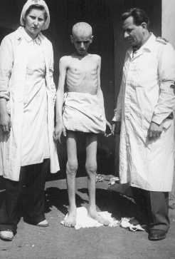
The U.S. Knew the Truth
FDR’s special envoy to the Vatican Myron C. Taylor wrote to Cardinal Maglione on September 26, 1942, “[Theresienstadt] is only an interim station and the people there await the same fate.”
Concerning the Danish reports (received in July 1944) the U.S. State Department internal telegram stated: “much of the visit suggests window dressing for propaganda purposes.”
September 15, 1944 a War Refugee Board internal telegram stated, “Theresienstadt has constantly served as a transit camp for other less “privileged” Jews.”
The same telegram later proves that the U.S saw past the farce: “The ICRC has expressly refrained from giving any publicity whatever to the June visit and observations of its delegate because it did not wish to gratuitously furnish material for German propaganda purposes…and because it was aware that the Germans quite possibly allowed Intercross to visit Theresienstadt in the hope that any Intercross report could be used to whitewash their treatment of the Jews in general.”
Letter dated October 26, 1944 (Roswell McClelland to John W. Pehle): “As is almost always the case with such “official” visits to camps or prisons, the reception of the ICRC’s representative as well as of the two delegates of the Danish Red Cross…was quite obviously prepared in advance. The various Jewish “officials” for example all gave interesting but clearly “prepared” speeches.”

Slide 13
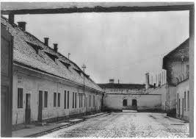
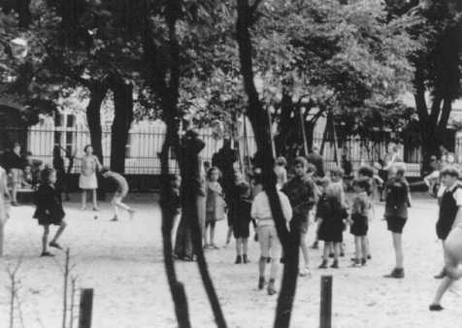
Research Challenges
Very few primary sources readily available
Online Archival Research (FDR Library) boxes were simply scanned and only loosely indexed
Unavailability of primary source documents in some cases
Few secondary sources in the years following the declassification of Rossel’s report and the War Refugee Board correspondences (In some ways this makes my research more interesting/valuable)

